Slide 1
ICT Gaming
Lesson 3

Slide 2
Basic Programming Concepts
Objectives
10.3.8: Explain the types and uses of variables in game programming.
10.3.9: Describe basic Boolean concepts, including logical operators, order of precedence, and expressions.
10.3.10: Describe the use of events, event handlers and functions in game programming.
10.2.11: Describe the use of parameters and arguments in game programming.
10.3.12: Describe the use of objects, classes and instances in game programming.
10.3.13: Describe the use of properties and methods with objects in game programming.

Slide 3
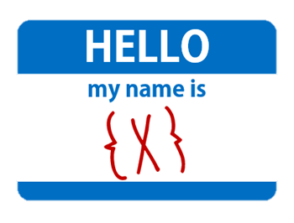
Variable
Variables are used to store information (in the computer's memory) that can be used in a program when executing detailed instructions.
Descriptive name: the type of data it stores, such as "playerName.”
Programs refer to the variable name

Slide 4
Variable
In Math: x=2 (x= the variable)
then: x+4=6
For example:
If the playerName variable stores the value ”Michael," then when the program instructs the computer to print playerName, the name Michael will be displayed on the screen.
If playerName changes to John, then the program simply changes the variable data to John (playerName = John). Every reference to the playerName variable will update to the new data.

Slide 5
Variables
Declaring: telling the program that the variable exists and the data type the variable will store
Initializing: assigning an original (initial) value
Expressions contain a combination of variables, values, functions and operators, which are evaluated and produce another value.
Similar to mathematical expressions: (2+8)*(2+1) evaluates to 30

Slide 6
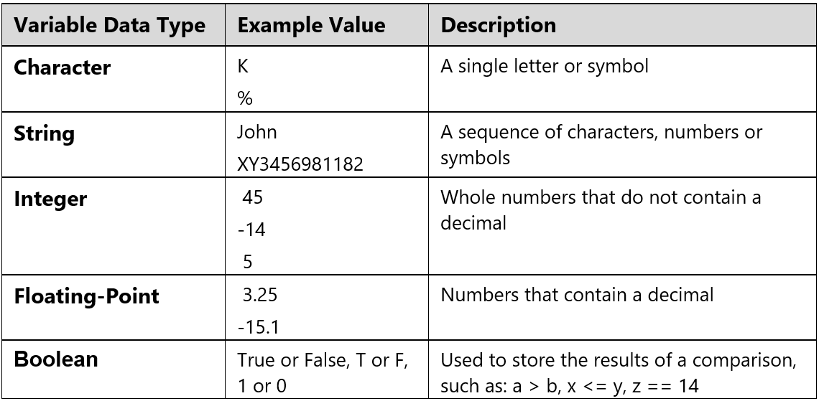
Data Types
Variables can hold different types of data and are classified based on the type of data they hold.

Slide 7
Operators
A program can do “operations” on a variable
An example would be a Score variable that adds up the points earned during a game
The equal sign (=) is considered an assignment operator in most programming languages.
Expressions are evaluated using the mathematical order of precedence:
1. Parentheses ( )
2. Exponentiation x^{y}
3. Multiplication and division * /
4. Addition and subtraction + -

Slide 8
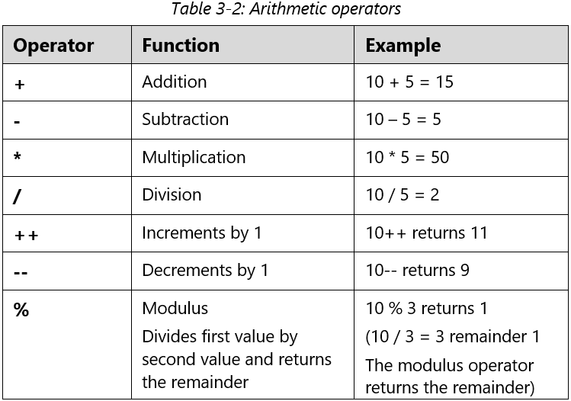
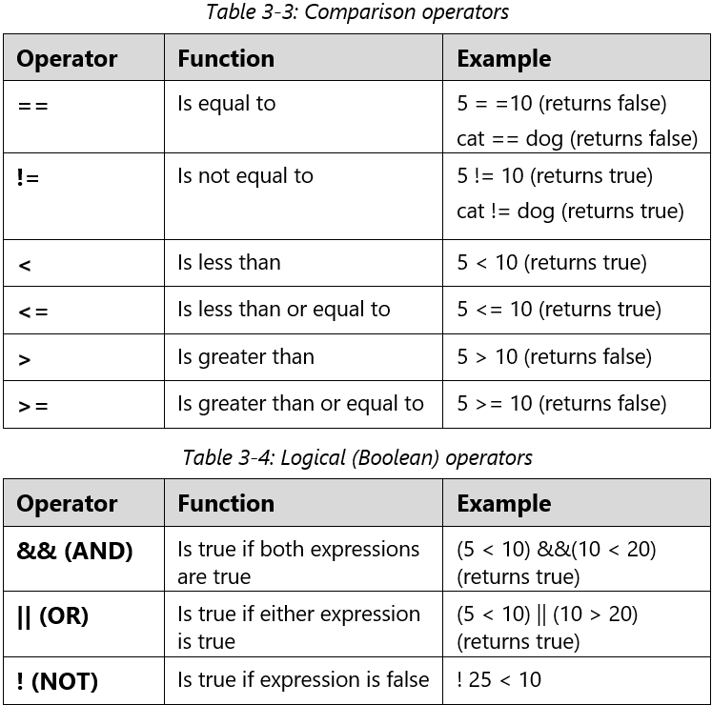
Operators

Slide 9
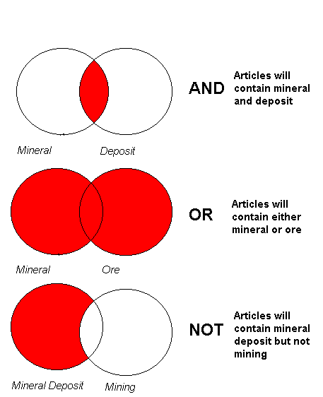
Boolean Operators
A Boolean (true or false) contains a condition and is often used in repetition and selection structures.
Example: If “light=red” is true, then “stop”, or else if false, then “go ahead”.
Conditional Booleans — check for a specific condition.
Comparative Booleans — compare values.

Slide 10
Boolean Operators
Conditional Boolean
The code looks for “peanuts”
If word exists, Condition is (=) True
If word does not exist (Else), Condition is (=) False
Comparative Boolean
If the code finds a “Yes”, then the code will make the statement.

Slide 11
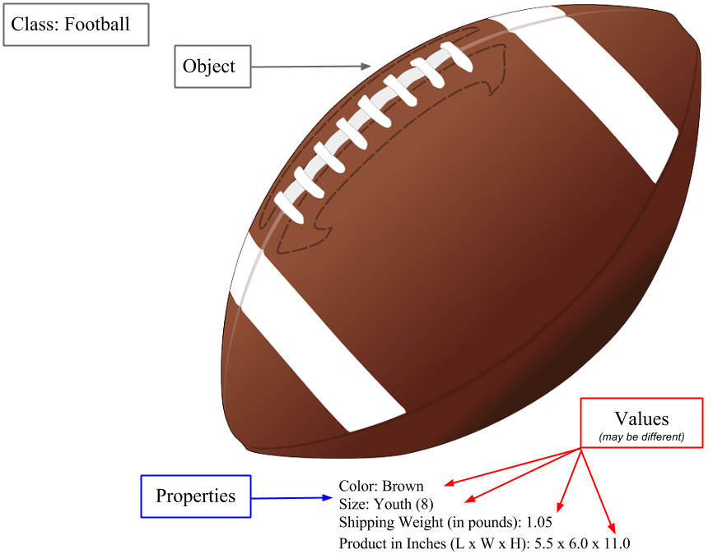
Class & Objects
A class is a definition or blueprint used to create a particular type of object.
A class provides a detailed description of the object's characteristics (such as that the object should include a size and a color), and it specifies what can be done with the object (its functions).
Characters in a game are a class of "Objects"

Slide 12
Properties & Instances
Properties are the various characteristics of an object, such as size, color and type.
Each object created using the class contains the same properties, but the values of the properties may be different.
When a class is used to build an object, the object is called an instance of the class.
Multiple objects (or instances) can be created using the same class.
Sprites are objects that can be cloned to create separate and varied instances of the sprite. The clone will inherit the scripts, costumes, sounds and properties of the parent sprite, but can be modified separately.

Slide 13
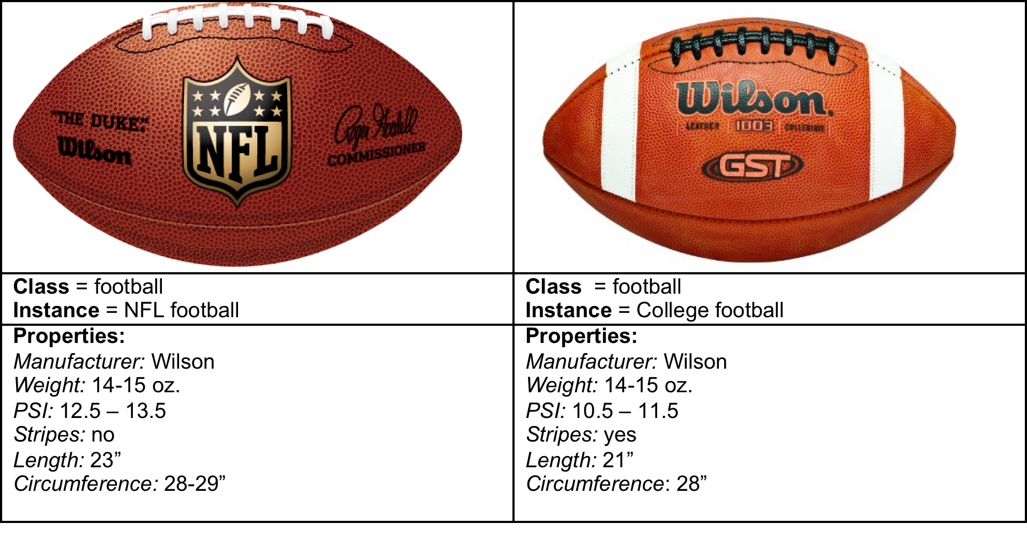
Class & Objects

Slide 14
Objects, Methods & Functions
Functions
Functions are actions that a class can do; but, are NOT part of the class description.
Functions are named units of code that perform a task or cause an action to take place.
A function is called upon or executed by a descriptive name, such as "move forward" or "jump up.”

Slide 15
Objects, Methods & Functions
Method
Actions that an object can perform and are a part of the object’s description (such as move, rotate or jump) are called methods in programming.
A method is a function of a class – in other words, it is actions the class can perform and is part of how the class is defined.
The methods that can be applied to the football object in a game program might be to bounce off walls, speed when thrown, or move up or down when the keyboard arrows are pressed.

Slide 16
Objects, Methods & Functions
Each object created using the class shares the same methods (functions) as all the other objects created from the same class.
That is, all objects in a class can do the same things, such as bounce off walls or speed when thrown.
Methods and functions are ONLY applied to a class.

Slide 17
Arguments & Parameters
Parameter
Methods need information that tells them how far, high, long ,etc…
A parameter is the variable that holds the argument data (value) needed by the method.
For example, degrees=90 or steps=10.

Slide 18
Arguments & Parameters
Argument
An argument is the value that is passed to a method when it is called so that it knows what to do.
For example, an argument given to the rotate method could be 90º or 180º.
So in this example:
Degrees and steps are the parameters.
The values assigned to the parameters — 90 and 10 — are the arguments.

Slide 19
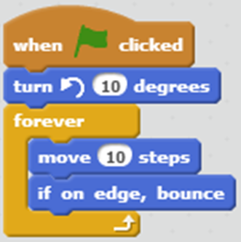
Events & Handlers
Event
An event is an action that takes place while a program is running, such as a mouse click or the pressing of a key.
It’s what you do that causes the method to execute.

Slide 20
Events & Handlers
Event Handler
An event handler contains the instructions to execute when the event occurs.
Event handlers are functions/methods.

Slide 21
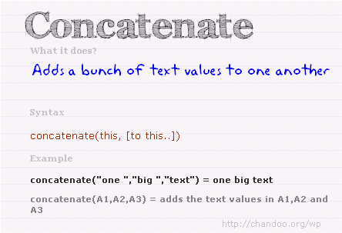
Concatenation
Concatenation means to merge 2 or more variables into a single expression

Slide 22
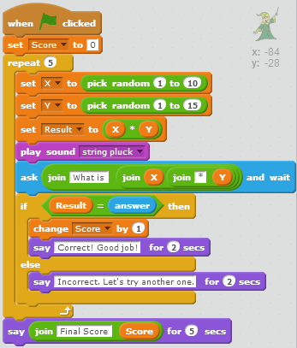
Practice
Label the following items in the picture using the letters below.
a. A variable
b. A variable value
c. An expression
d. An event
e. A loop structure
f. A selection structure
g. A sequence structure
h. A concatenation
i. An operator

Slide 23
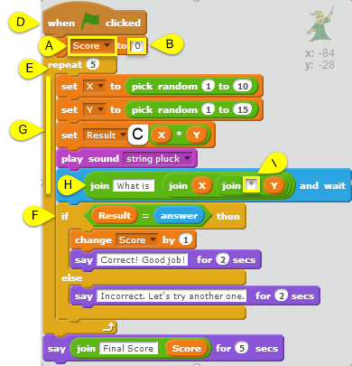
Practice
Label the following items in the picture using the letters below.
a. A variable
b. A variable value
c. An expression
d. An event
e. A loop structure
f. A selection structure
g. A sequence structure
h. A concatenation
i. An operator

Slide 24
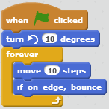
Example
Example of a Method
Method: Turn left (function)
Parameter: degrees
Argument: 10

Slide 25
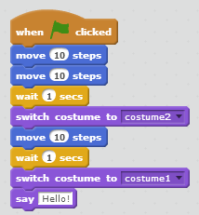
Example
Event: When clicked
Method: Switch (no function)
Parameter: costume
Argument: costume1 / costume2

Slide 26
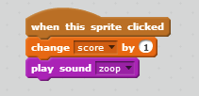
Example
Event: When this sprite clicked
Class: Character
Method: Play
Function: None
Parameter (Variable): Sound
Argument: zoop
Change score by 1 is a function.
Your character is playing the sound, so the "play sound" is a Method.

Slide 27
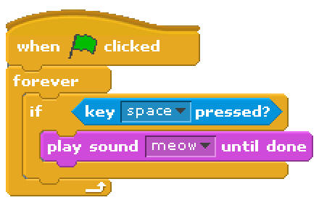
Practice
Event:
Key space pressed
Method:
Play
Parameter:
Sound
Argument:
Meow
Function:
until done

Slide 28

Review: Class - Object
Class: Chair
Properties:
Base: Roller
Back: High
Color: Tan
Covering: Leather
Object: The specific object described
by the properties and their values.

